Slide 1
lifting jack

Slide 2
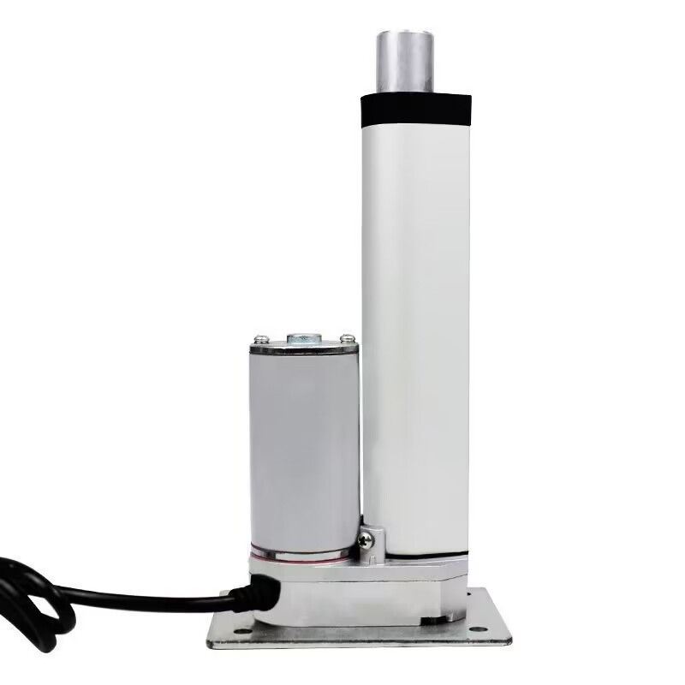
stroke 10cm or 15cm
weight 0.8 kg
Voltage 12v24v
thrust 10 to 100 kg
https://mobile.yangkeduo.com/goods2.html?refer_share_id=ZWEC1rT2FLR0WEobMcSNYT2dmau6Rjyt&refer_share_channel=copy_link&_oak_share_detail_id=0&pxq_secret_key=KZAQZD4A3UBAXBRJPHS4SVIOI5DJRE3V32VRRKCQWBQ45YSL2K6A&_wvx=10&_oak_share_time=1689141290&_wv=41729&share_uin=XLCS3Y7T2CQGYFPGDZIQPTTJQ4_GEXDA&_x_query=%E5%8D%87%E9%99%8D%E5%99%A8%20%E4%B8%8A%E4%B8%8B%20%E5%B0%8F%E5%9E%8B&page_from=402&refer_share_uin=XLCS3Y7T2CQGYFPGDZIQPTTJQ4_GEXDA&goods_id=453682224899&_oak_share_snapshot_num=9000&_x_org=1

Slide 3
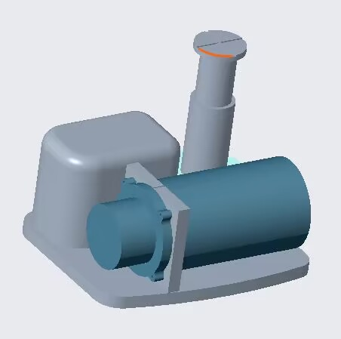
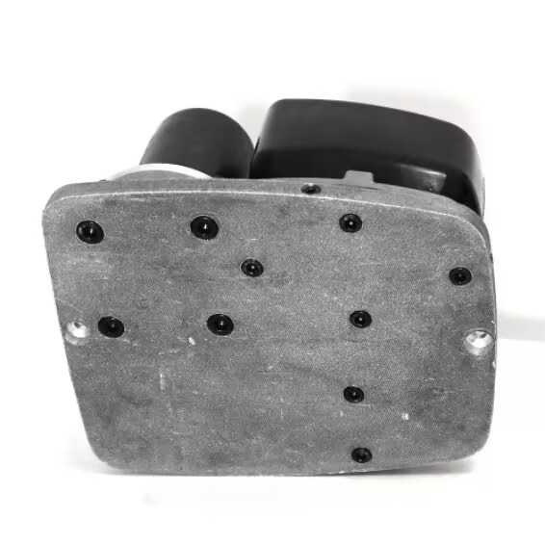
stroke 10-14.5cm
weight 4.4 kg
【淘宝】https://m.tb.cn/h.5ZoEieq?tk=9yF7dtObjj6 CZ3457

Slide 4
air bag

Slide 5
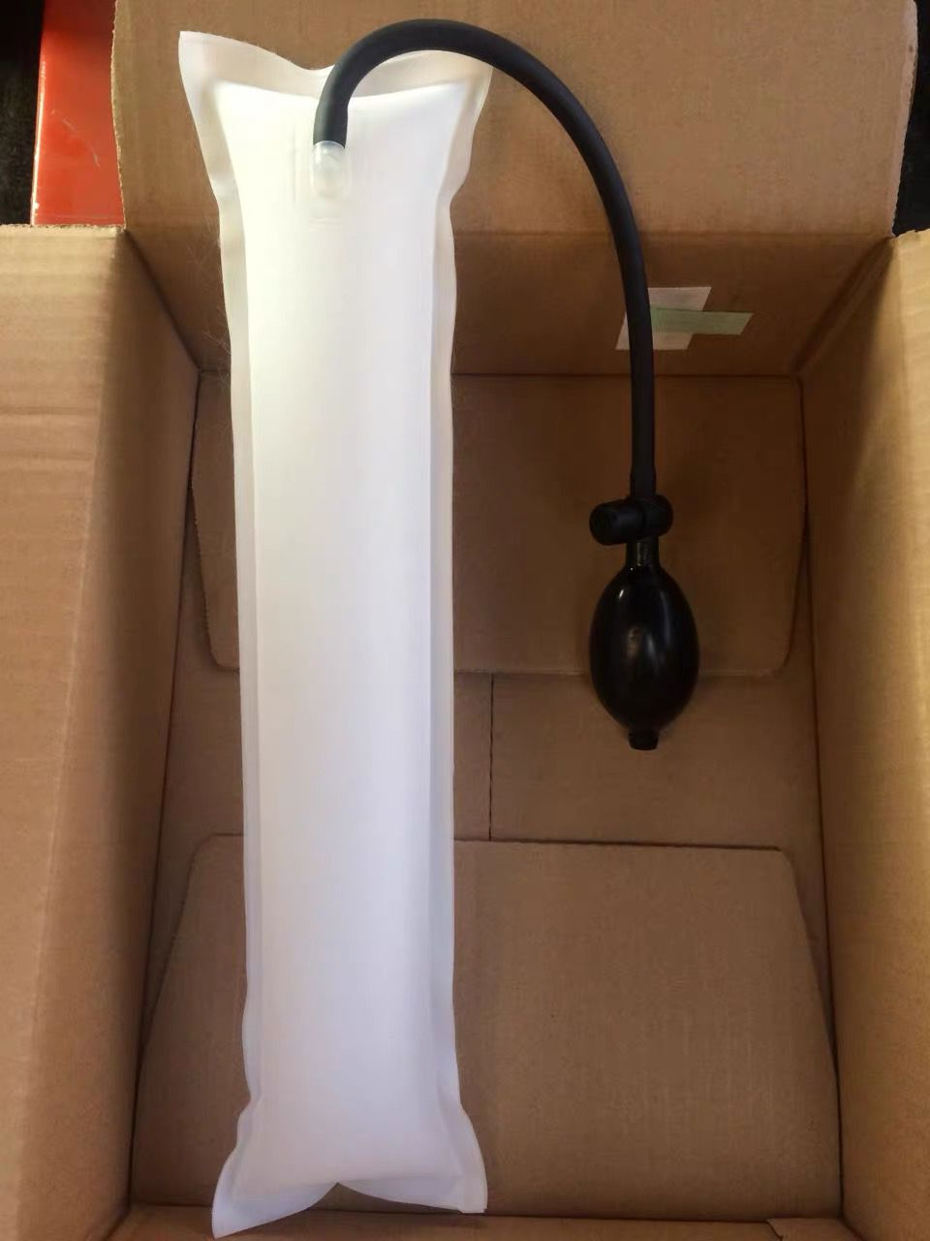
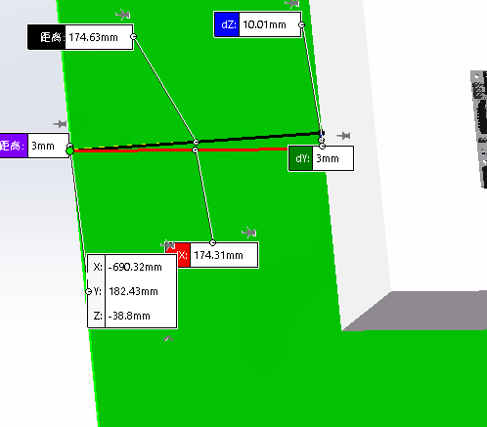
PlanA
Using size 20 × 20 × 10 airbags (assuming turtle shell size of 40 × 50 × 15)
Volume 20 × 20× 10The buoyancy of a airbag in water is approximately 39.2 Newton, which is 4 kilograms
TPU充气气囊定制
【淘宝】https://m.tb.cn/h.5ZoNHRP?tk=l1jfdtlGGES CZ3457

Slide 6
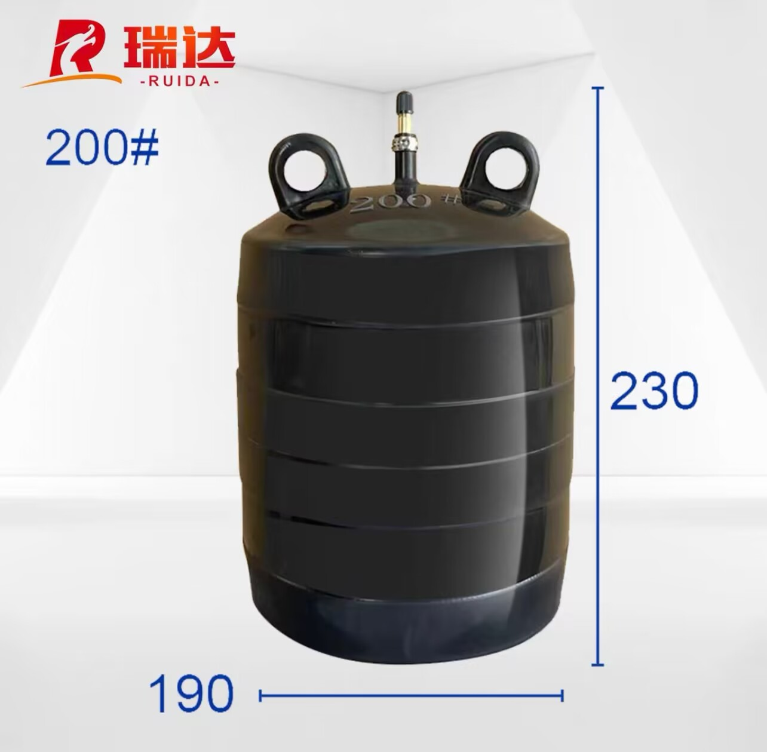
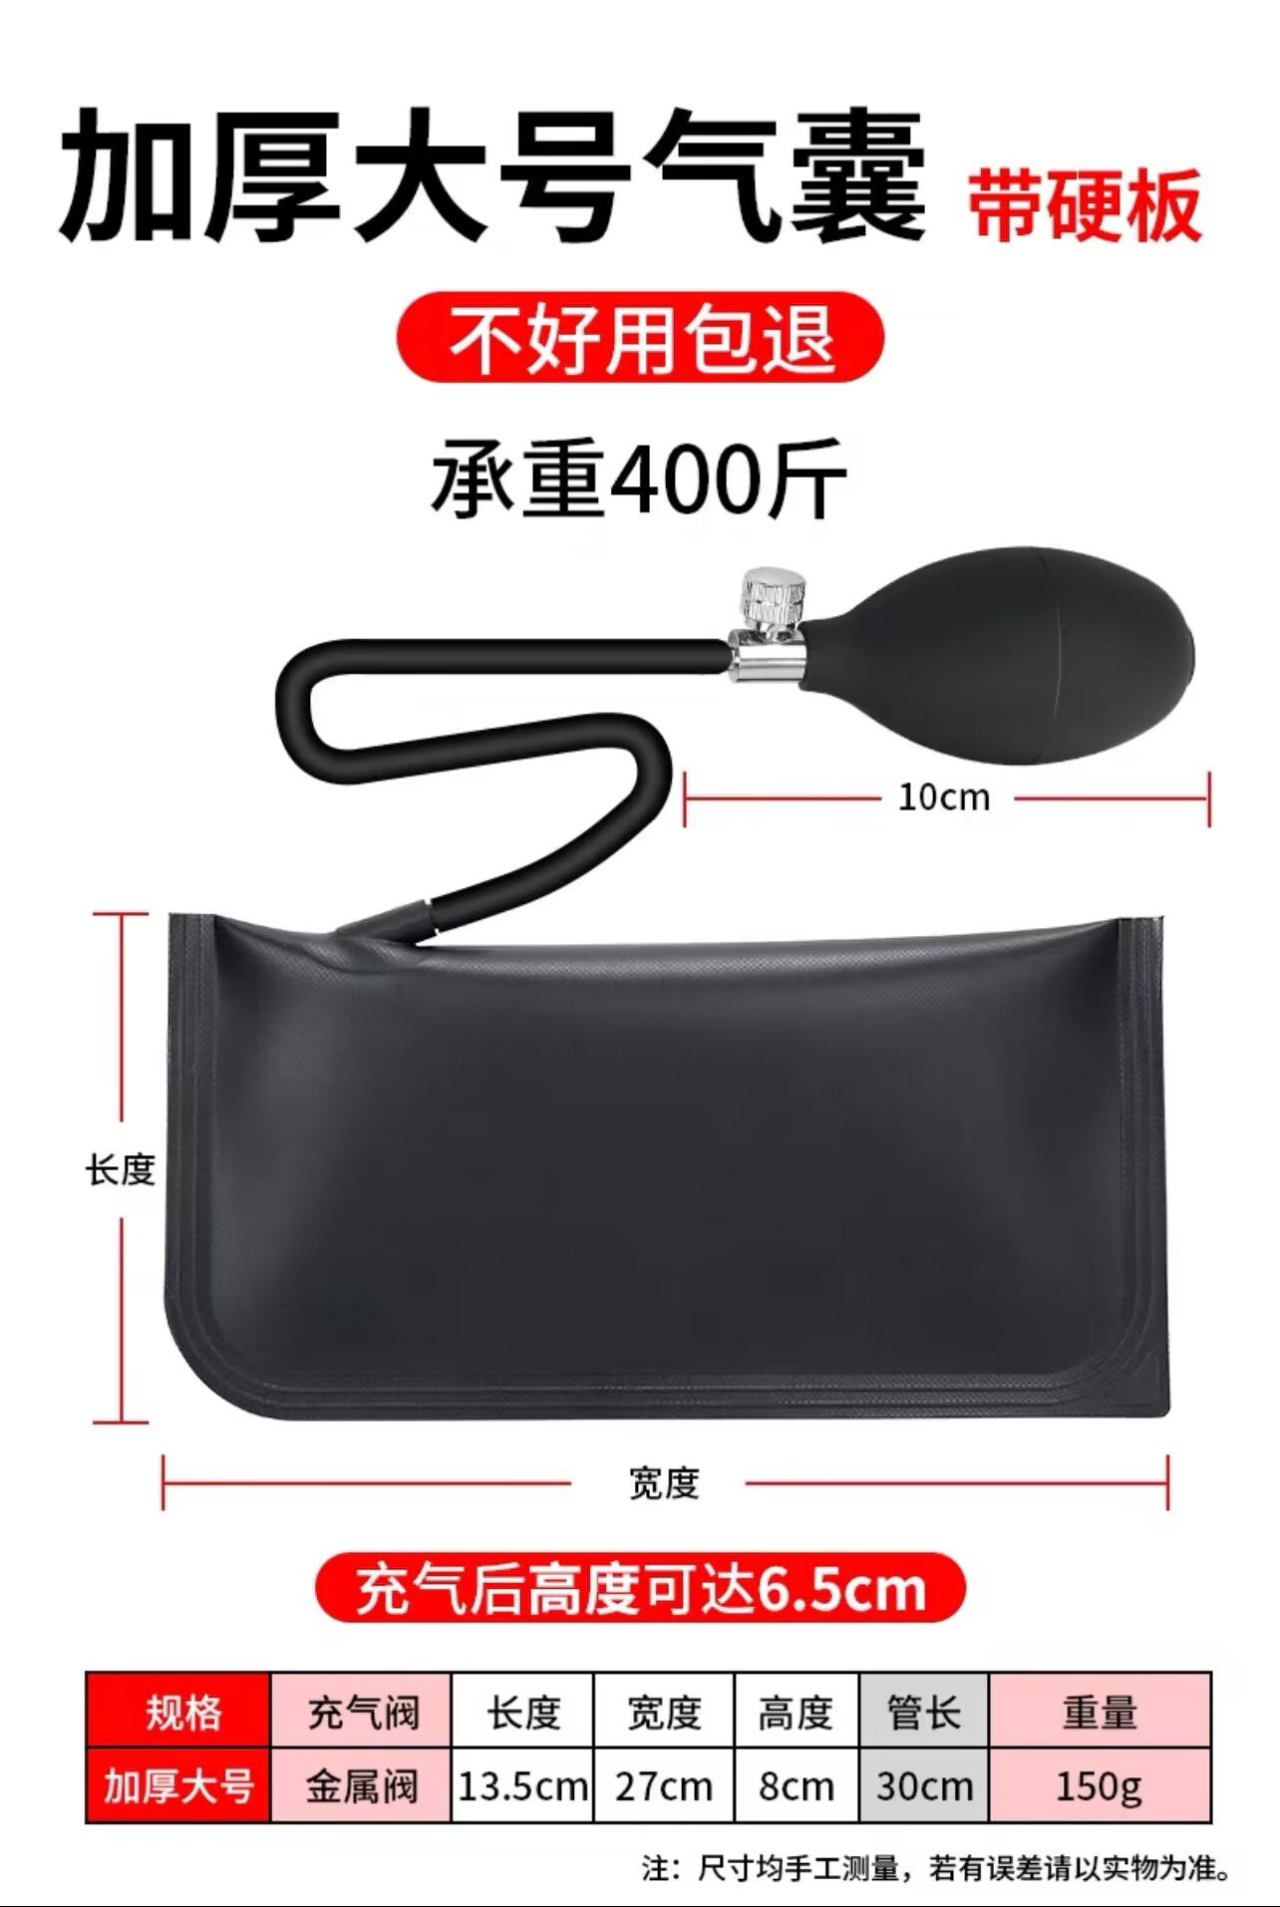
PlanA
【淘宝】https://m.tb.cn/h.505h2GC?tk=Uz79dtQswG1 CZ0001
【淘宝】https://m.tb.cn/h.5Zm6vB4?tk=GsaFdtQqjDs CZ3457

Slide 7
PlanB
Make a maximum size shell and place the airbag inside

Slide 8
Waterproof

Slide 9
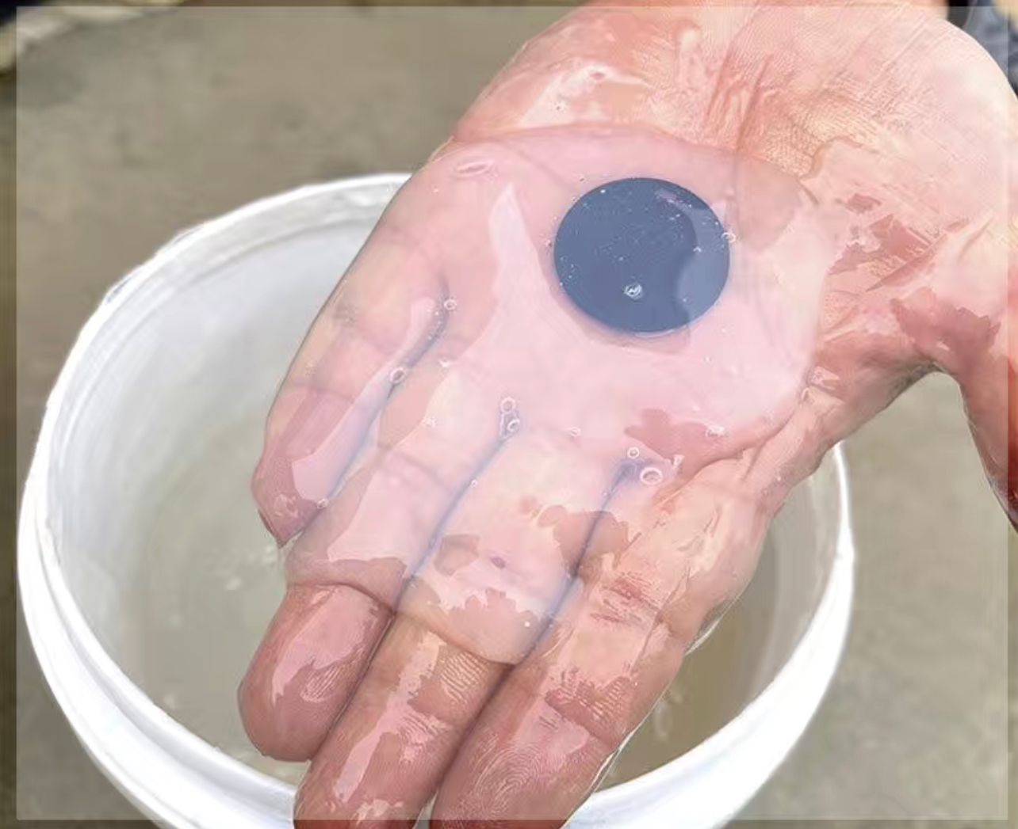
丙烯酸涂料
https://mobile.yangkeduo.com/goods2.html?refer_share_id=MdvTqS27GLvGGL3NJX6QKU50J830Eidl&refer_share_channel=copy_link&_oak_share_detail_id=0&pxq_secret_key=KZAQZD4A3UBAXBRJPHS4SVIOI6XWY3Z6IE3NKMCHPXQZUI5NY7RA&_wvx=10&_oak_share_time=1689143575&_wv=41729&share_uin=XLCS3Y7T2CQGYFPGDZIQPTTJQ4_GEXDA&_x_query=%E9%98%B2%E6%B0%B4%E8%9C%A1%E8%83%B6&page_from=23&refer_share_uin=XLCS3Y7T2CQGYFPGDZIQPTTJQ4_GEXDA&goods_id=499973065448&_oak_share_snapshot_num=970&_x_org=1

Slide 10
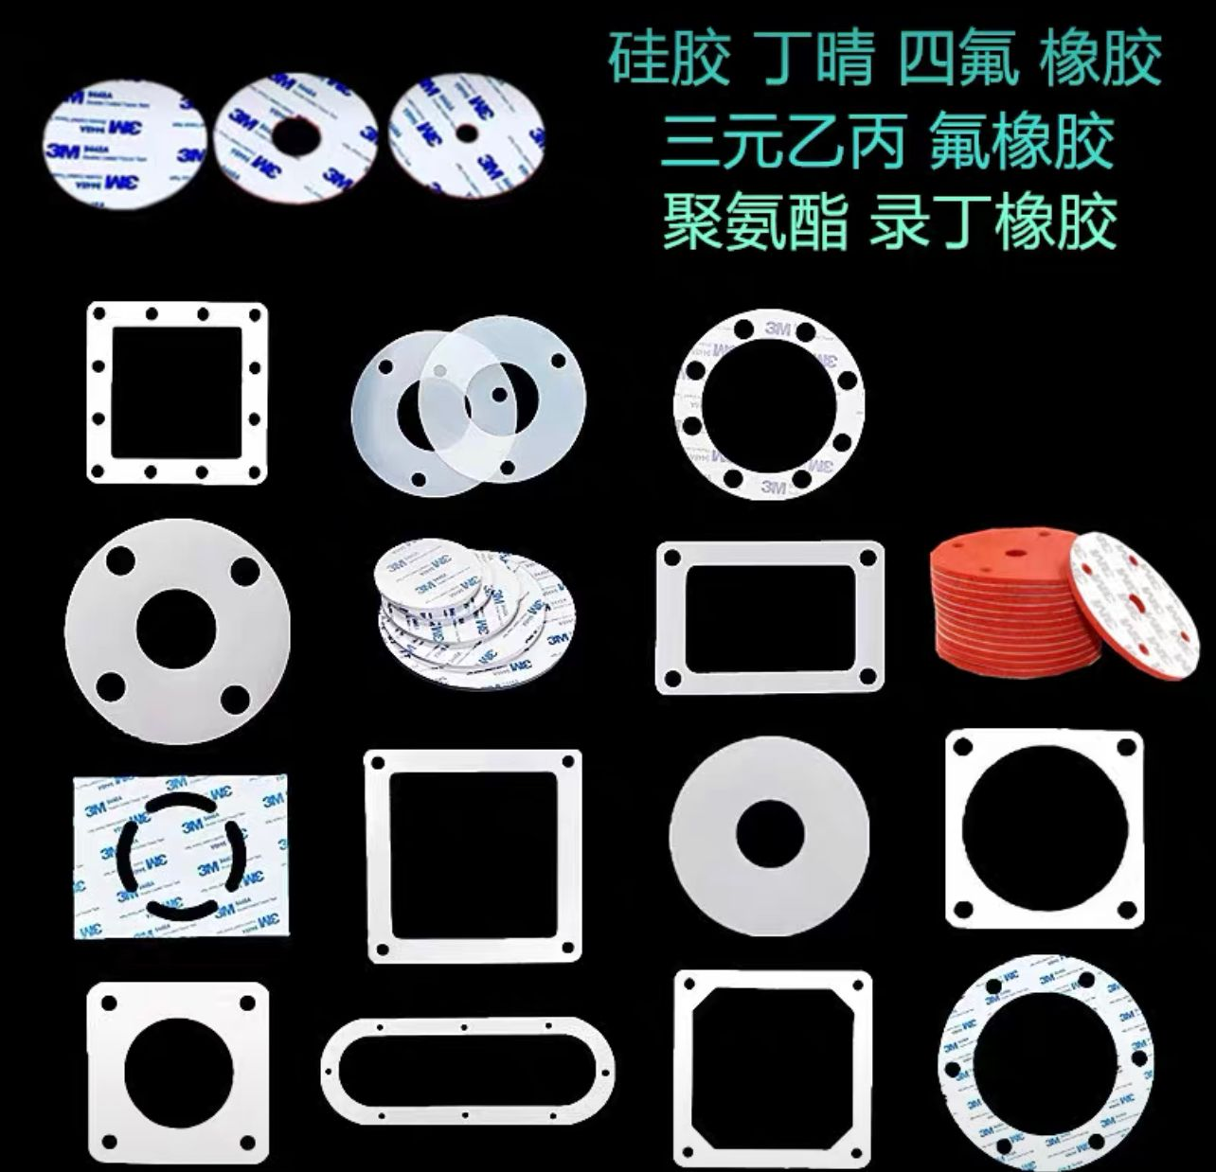
内舱用防水胶垫加螺丝
可定制胶垫
【淘宝】https://m.tb.cn/h.5bBursL?tk=3EladtNTLgK CZ0001

Slide 11
Modeling

Slide 12
external cavity

Slide 13
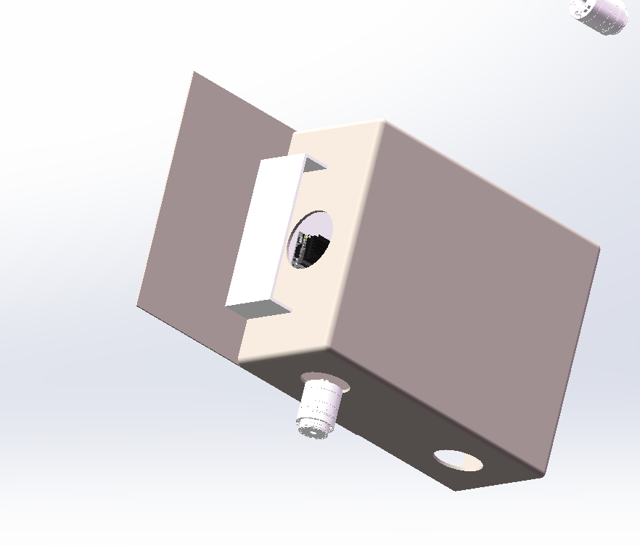

Slide 14
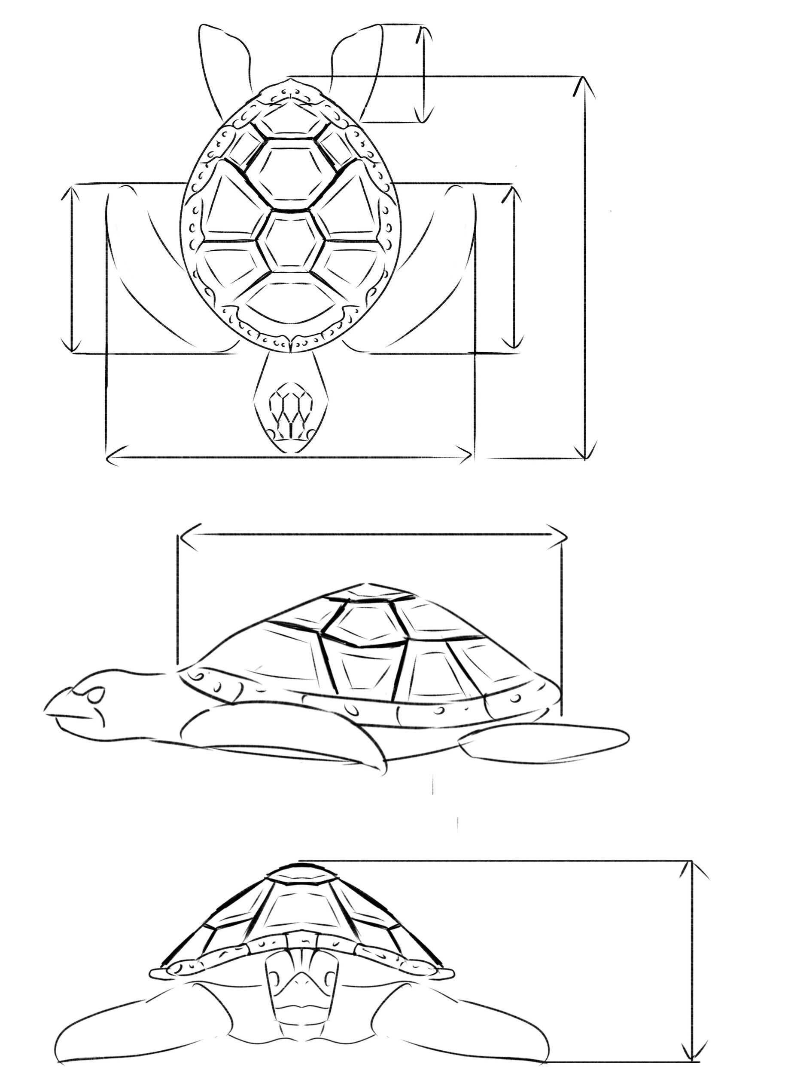

Slide 15
inner cavity

Slide 16
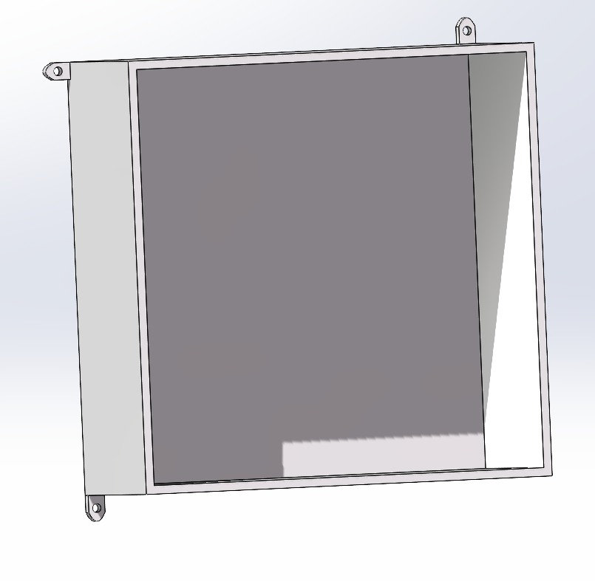
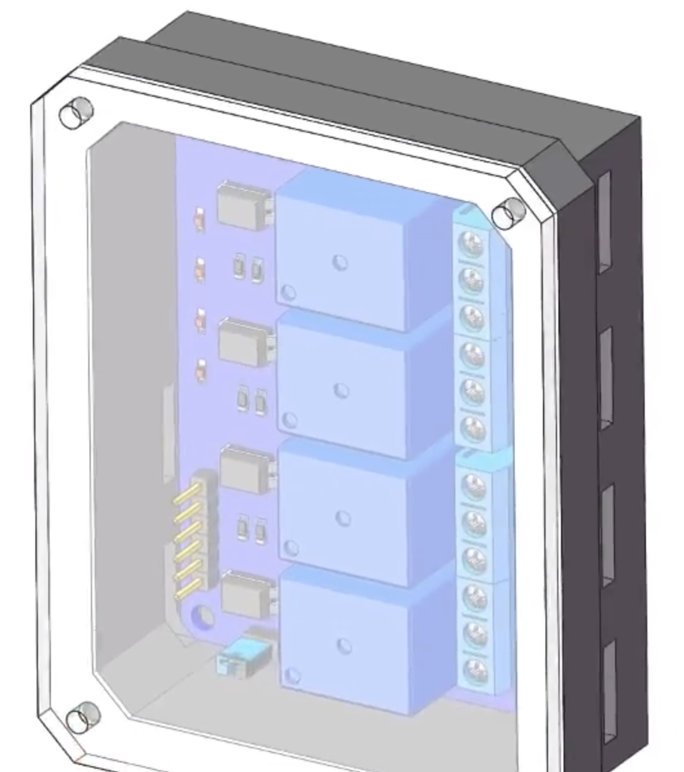
1.
2.直接打孔
两种结构
密封用亚克力板加胶垫加螺丝

Slide 17
SolidWorks stress analysis

Slide 18
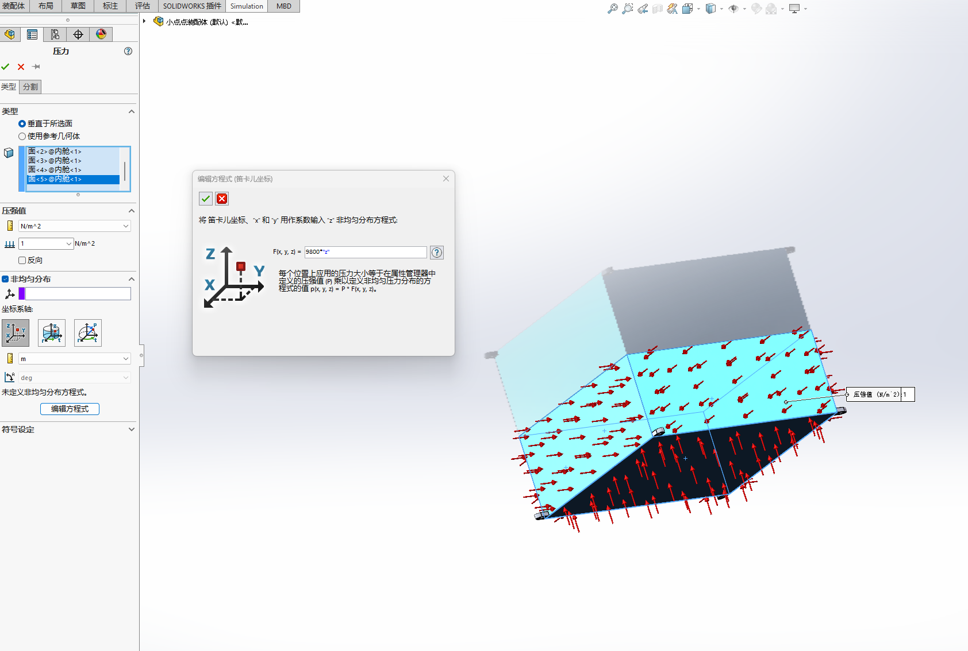
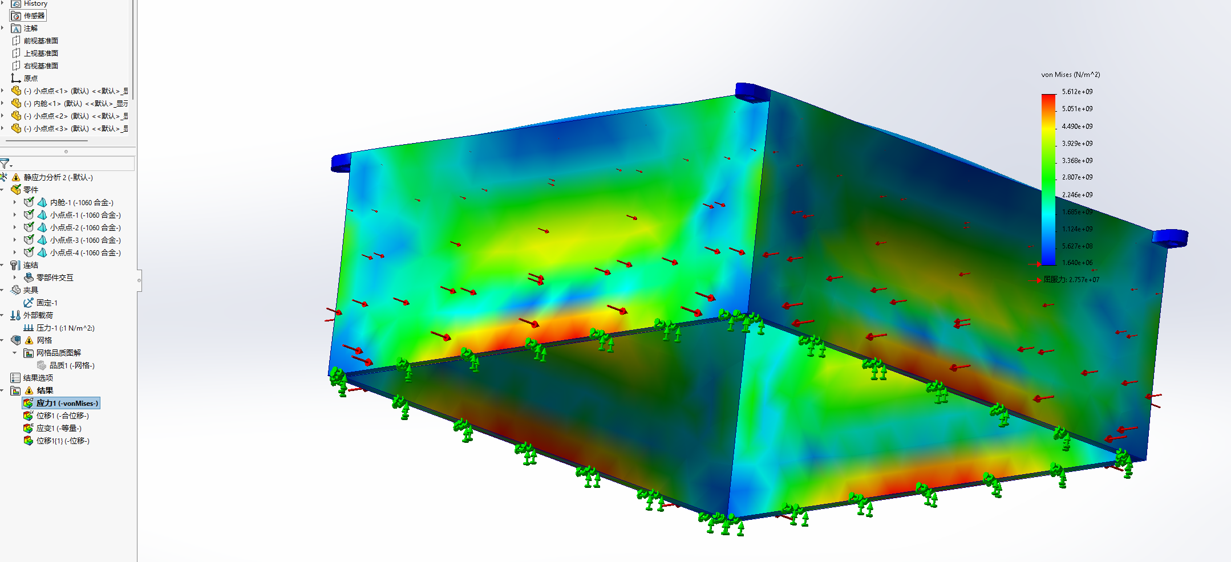
Simulate underwater

Slide 19
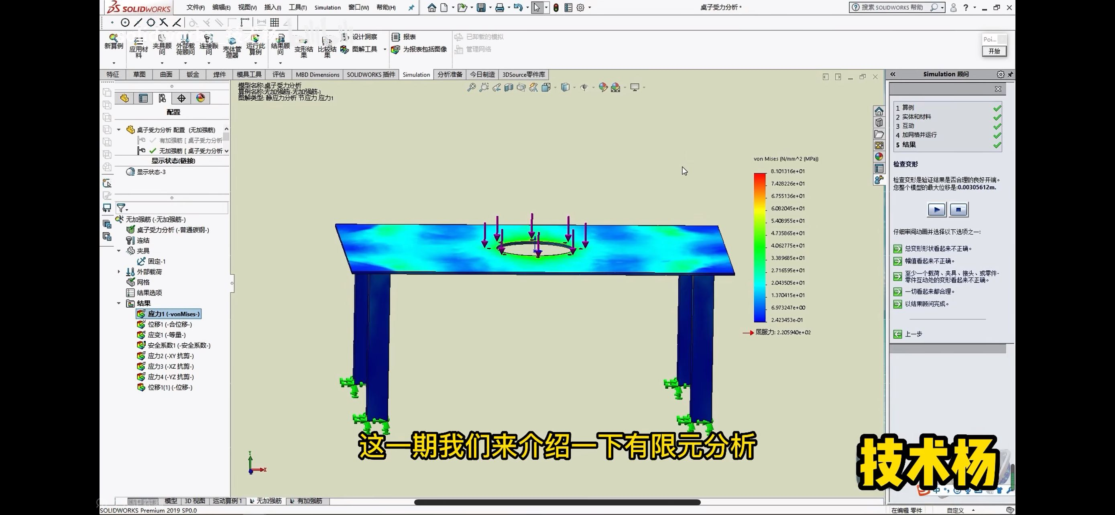
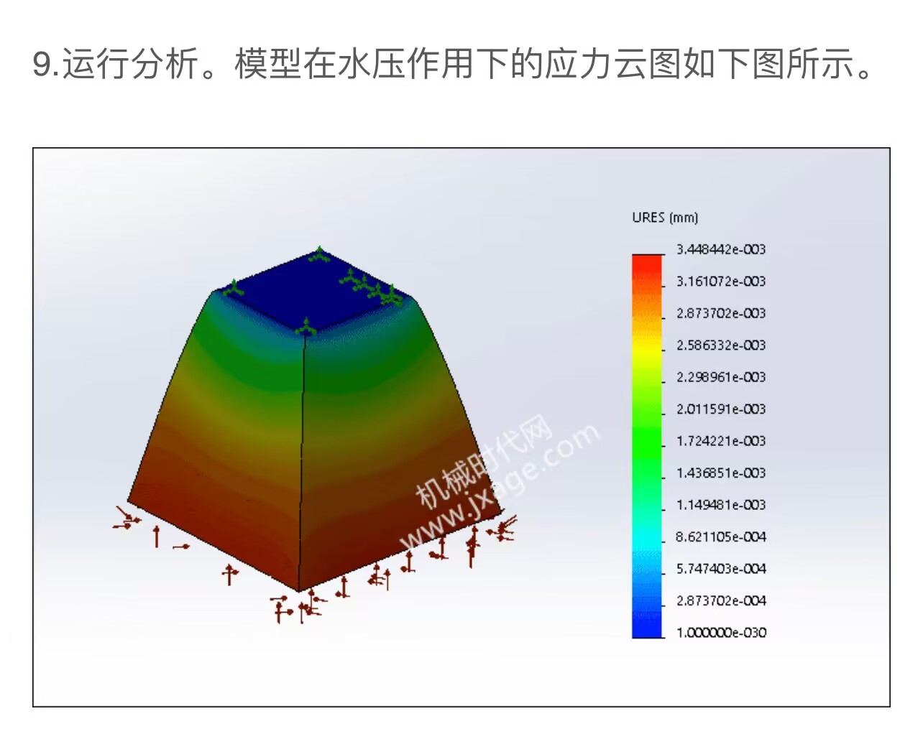
有限元分析以及模拟温度

